Slide 1

Business Insights 360

Slide 2
Agenda
Problem Statement
Objective
Project Work Flow
Rough Dashboard sketches
Conclusion

Slide 3
Problem Statement
AtliQ Hardware, a leading consumer electronics company, operates globally with a diverse customer base, similar to well-known brands like HP and Dell. While AtliQ Hardware has been experiencing rapid growth, it has encountered challenges in the Latin American market. These challenges stem from their reliance on Excel files for data management. Excel, although versatile, presents difficulties in terms of data comprehension, visualization capabilities, and scalability. These limitations have led to significant losses in the Latin American market.

Slide 4
Objective
To Deploy an advanced analytics solution for AtliQ Hardware to enhance data analysis efficiency. which will offer comprehensive insights tailored to meet the needs of business leaders across various domains, such as Sales, Finance, Marketing, Supply Chain, and Execution.

Slide 5
Project Work Flow
Project Planning
Data Collection & performing
ETL
Data Modeling
Dashboard Building
Stake holder
Feedback Implementation

Slide 6
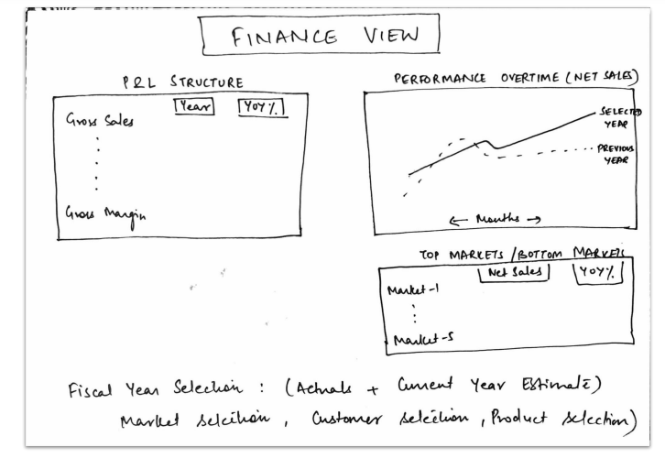
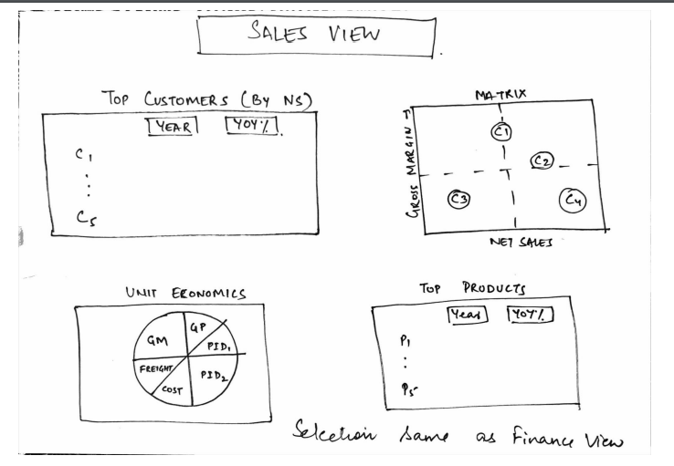
Rough Dashboard Sketches

Slide 7
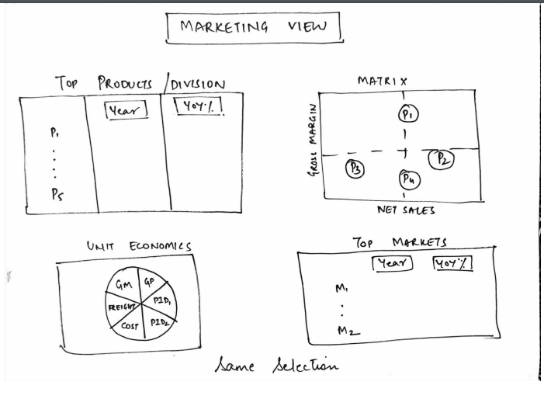
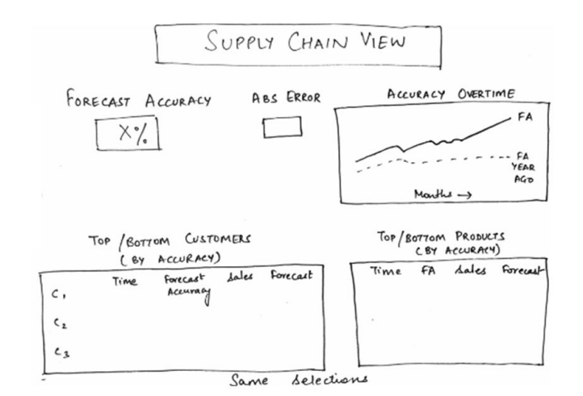

Slide 8
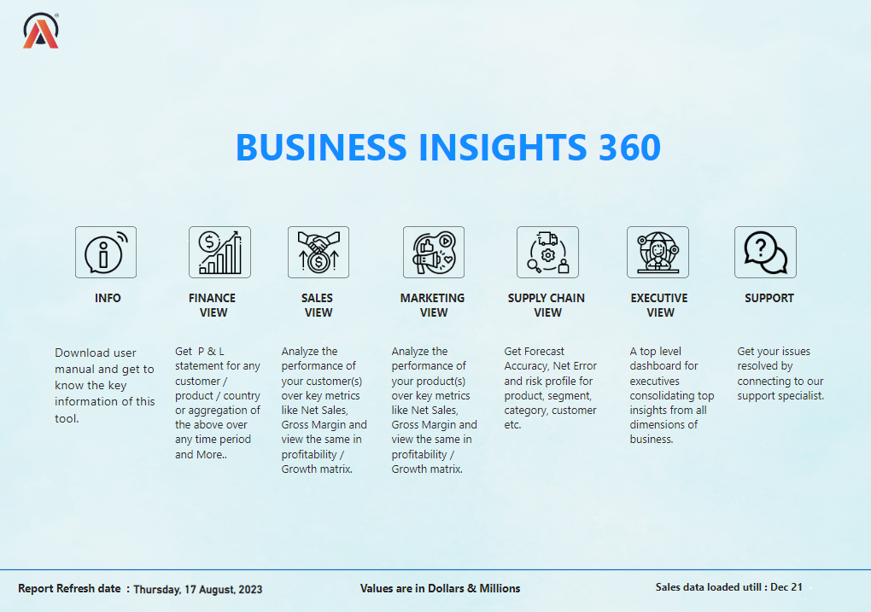

Slide 9
Conclusion
The dashboard has equipped AtliQ Hardware with the capability to assess sales trends across different departments and make decisions guided by data. Moreover, a notable/significant trend on consistent rise in Atliq market share, witnessing a substantial growth from its initial share of less than 0.5% to an impressive 5.9%. This encouraging trajectory highlights AtliqQ increasing presence and competitiveness in the market

